Slide 1




RAJASTHAN POLICE HACKATHON 1.0

Slide 2
POLICE FEEDBACK
SYSTEM
Jaipur Caps

Slide 3

EXPECTED SOLUTION
BULK SMS TOOL
SOCIAL MEDIA
Gather quick feedbacks on experiences
Allow users to share experiences.
ONLINE PORTAL
AUTO CHATBOT
Record detailed comments for a holistic view.
Engage users with questions and compile answers in real-time.

Slide 4

BULK SMS TOOL
Expectation- Gather quick feedbacks on experiences
When a police officer register the FIR, an SMS is sent to the citizen for initial feedback.
Bulk Sms Tool
Citizen will receive the SMS after 7 days of registration if FIR is not resolved.
Citizen will receive the SMS if his FIR is resolved or after 3 months to provide the final feedback.
Citizen can directly fill the feedback through the link provided in SMS.
Citizen can fill the feedback form through AutoChat Bot or manually.

Slide 5
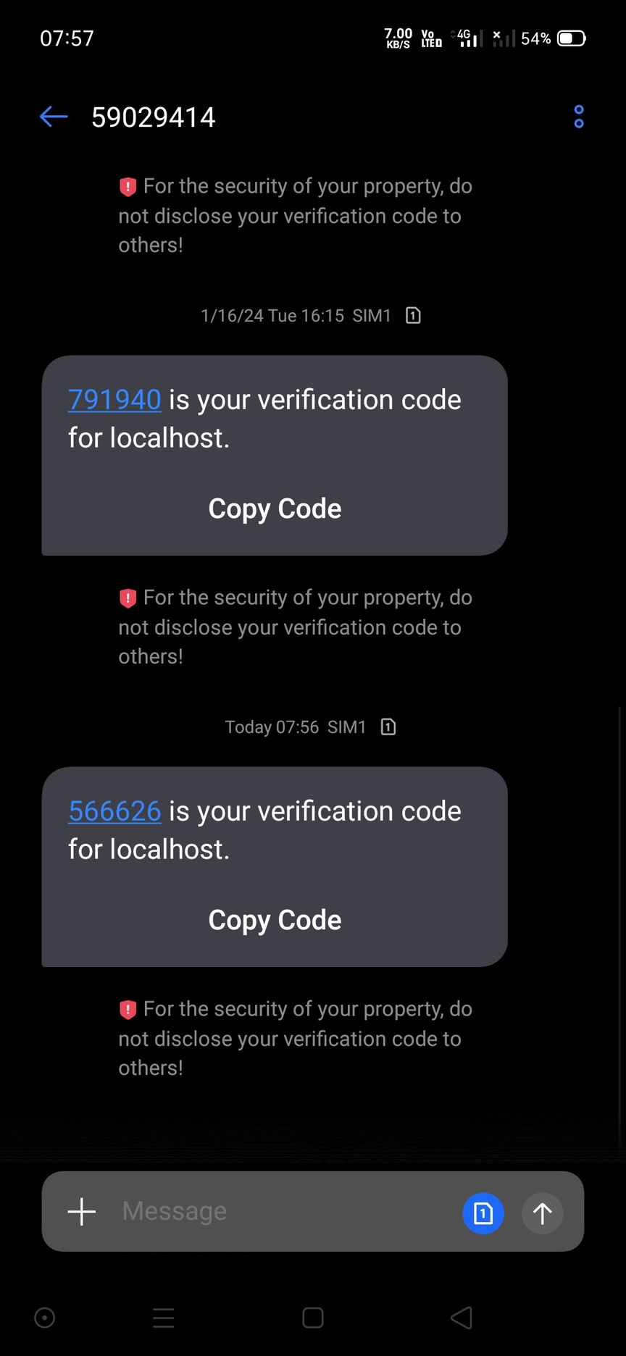
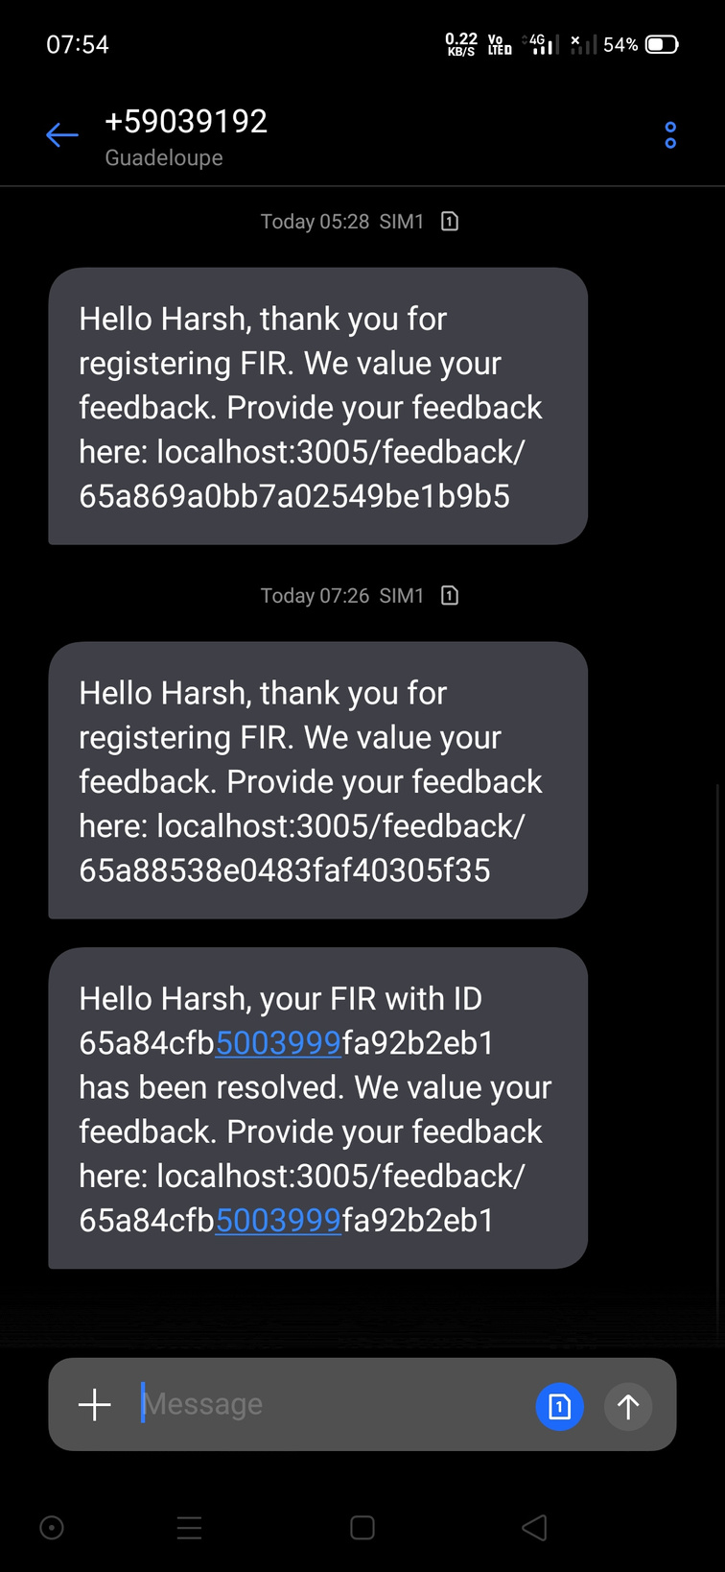
SCREENSHOTS
Registration OTP
Initial Feedback
Feedback after Resolution

Slide 6

ONLINE PORTAL
Expectation- Record detailed comments for a holistic view.
After successful registration of FIR, citizen can fill the feedback form provided through SMS.
Citizen will receive link to the feedback form after 7 days if his FIR is not resolved.
Citizen will receive link to the feedback form if his FIR is resolved or each month upto 3 months if his FIR is not resolved.
ONLINE PORTAL
We have also provided a Suggestion form, where citizen can give the suggestion anoymously.

Slide 7
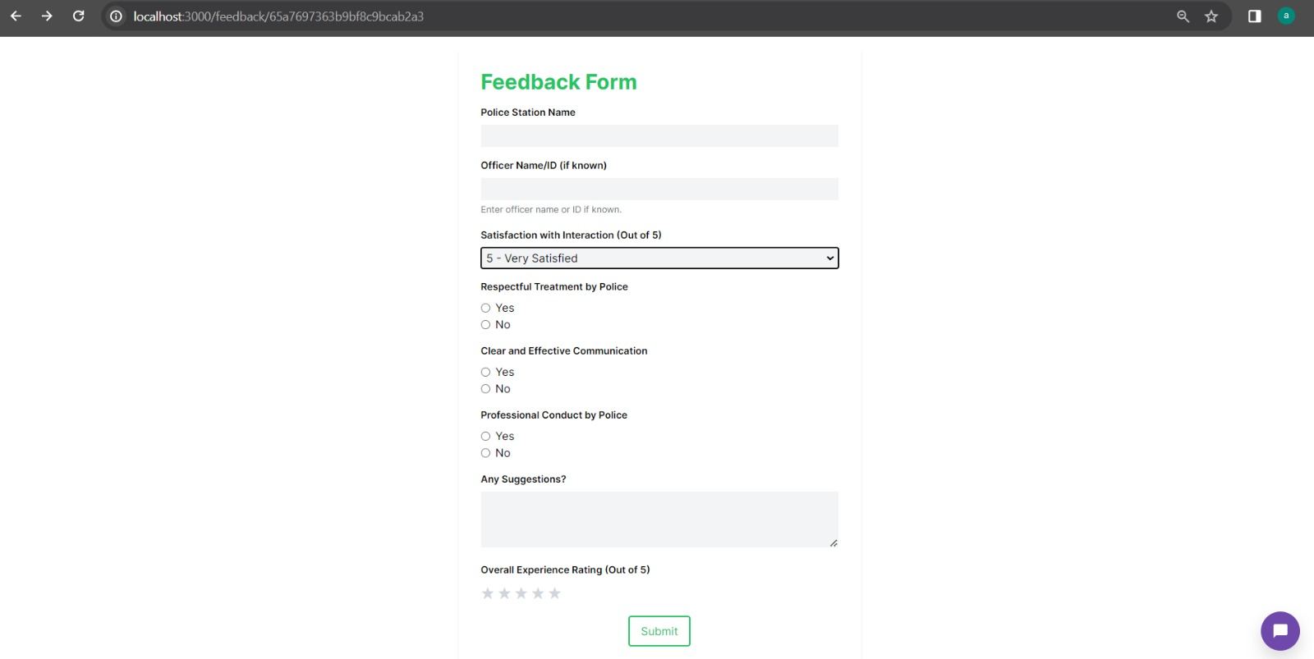
FEEDBACK FORM

Slide 8

AUTOCHAT BOT
Expectation- Engage users with questions and compile answers in real-time.
Citizens can provide the feedback through Autochat Bot.
Citizens can either fill the feedback form manually or can fill it using Auto Chatbot.
Citizens can provide input through speech also.
AUTO CHATBOT
Autochat Bot is voice assisted.
Autochat Bot is user friendly as well as mobile friendly.

Slide 9
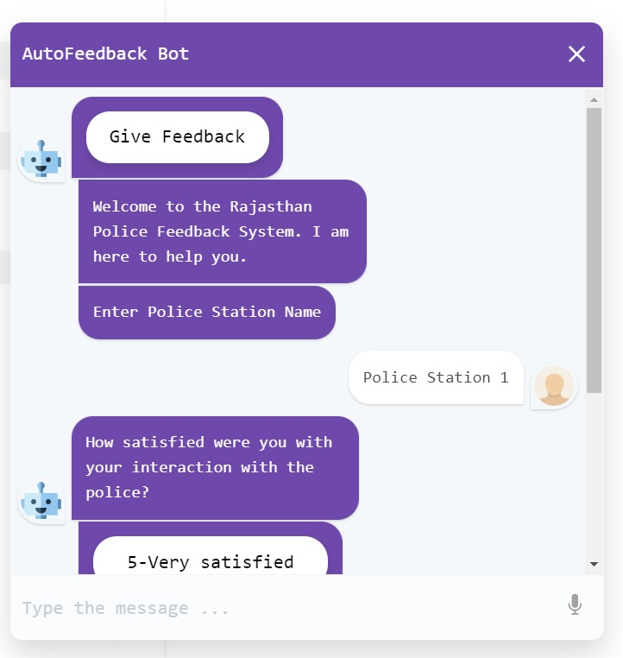
FEEDBACK THROUGH CHATBOT

Slide 10

COMMUNITY- SOCIAL MEDIA
Expectation-Allow users to share experiences.
SOCIAL MEDIA
We have created a Community for citizens to appreciate police officers and share their experiences with others.
Citizens can also Like and Comment on the post of other citizens.
Community can be accessed by Police as well as citizen.
It is user-friendly as well as Mobile Friendly.

Slide 11
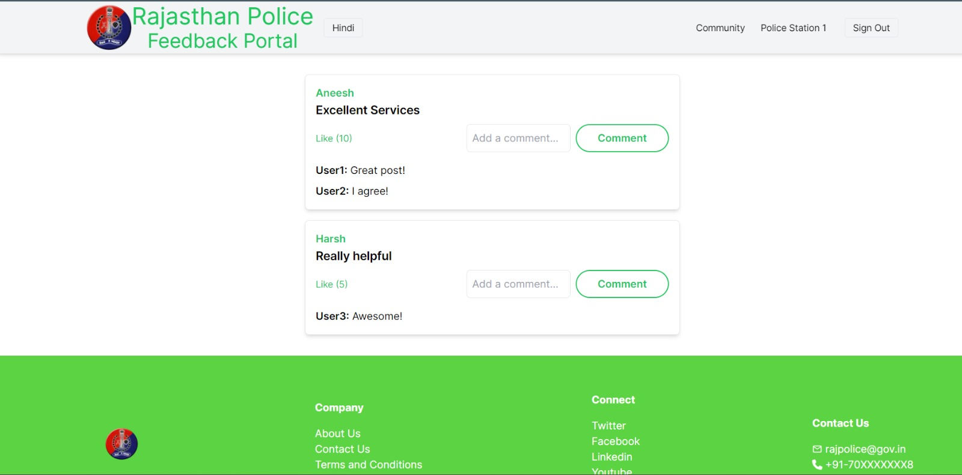
COMMUNITY PAGE

Slide 12
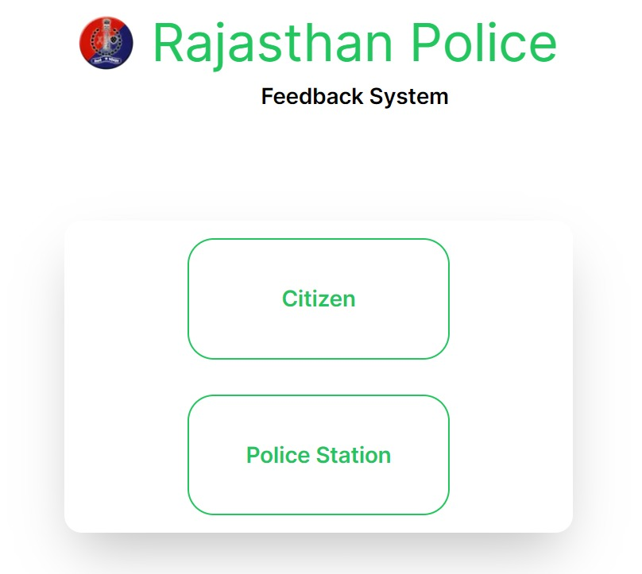
MAIN PAGE

Slide 13
”SPECIAL
FEATURES”

Slide 14





SPECIAL FEATURES
01 - BOOK APPOINTMENT
02- ANOYMOUS SUGGESTIONS
03-DATA ANALYTICS
04 - MULTI-LINGUAL
05 - AUTO DATA ENTRY

Slide 15
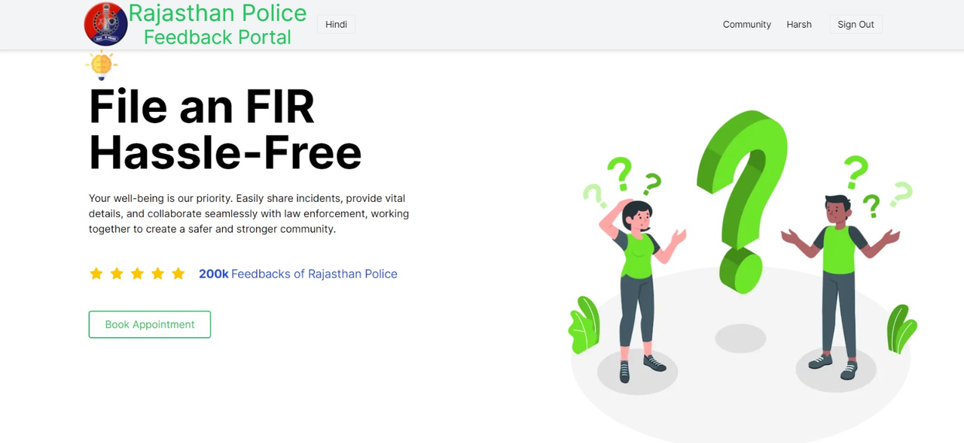
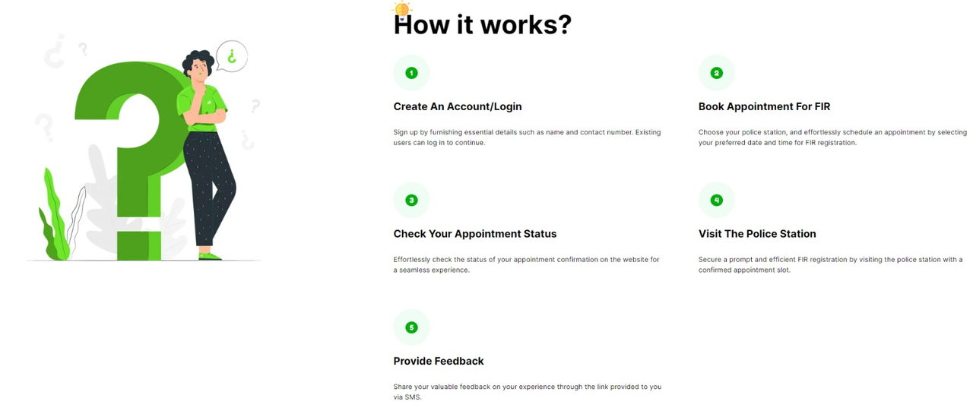
USER HOME PAGE

Slide 16
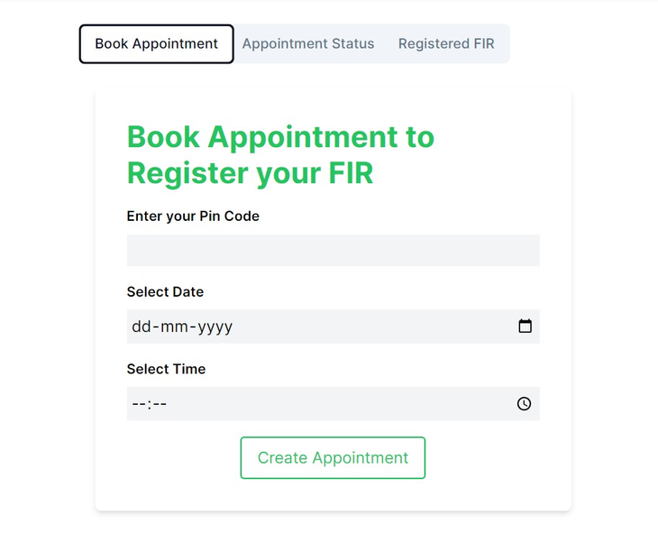
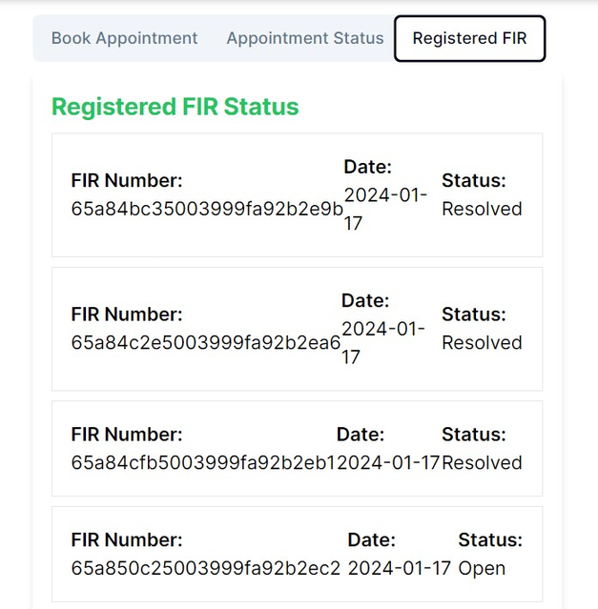
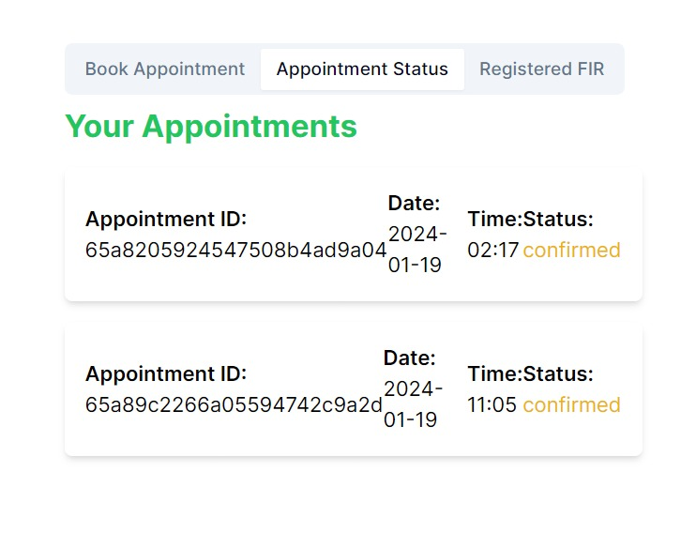
USER APPOINTMENT FIR

Slide 17
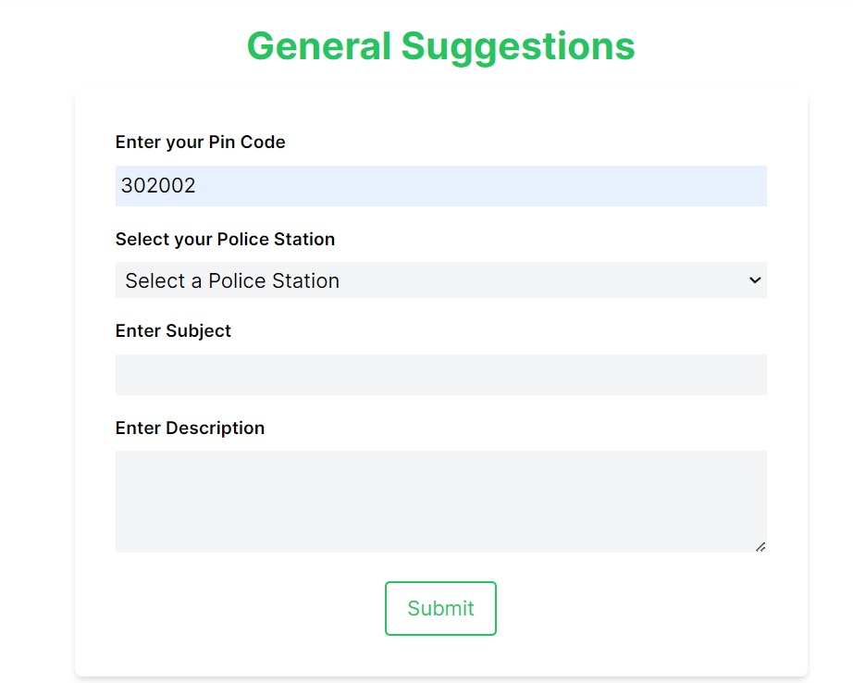
GENERAL SUGGESTION FORM

Slide 18
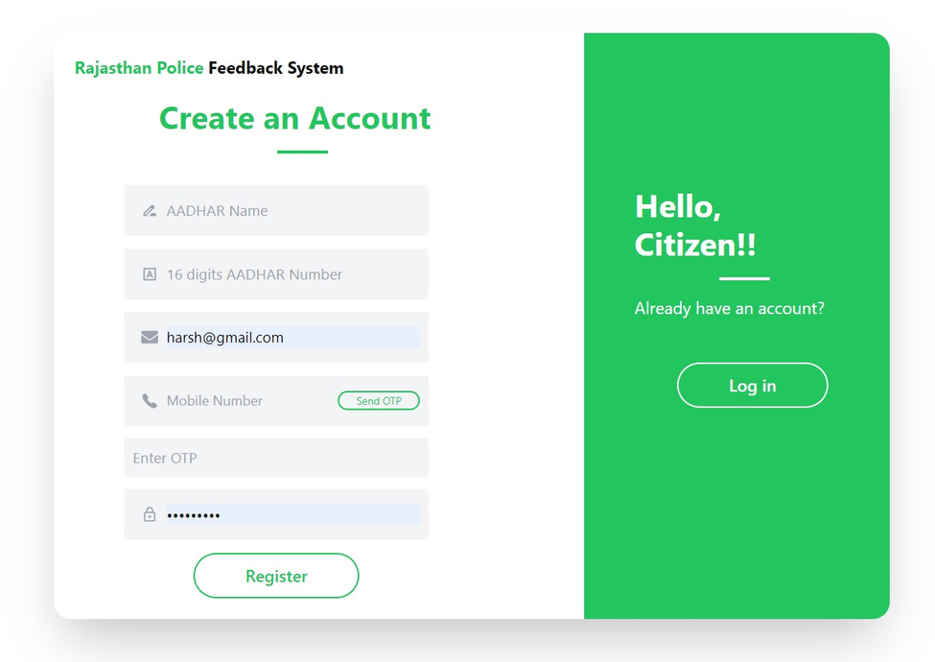
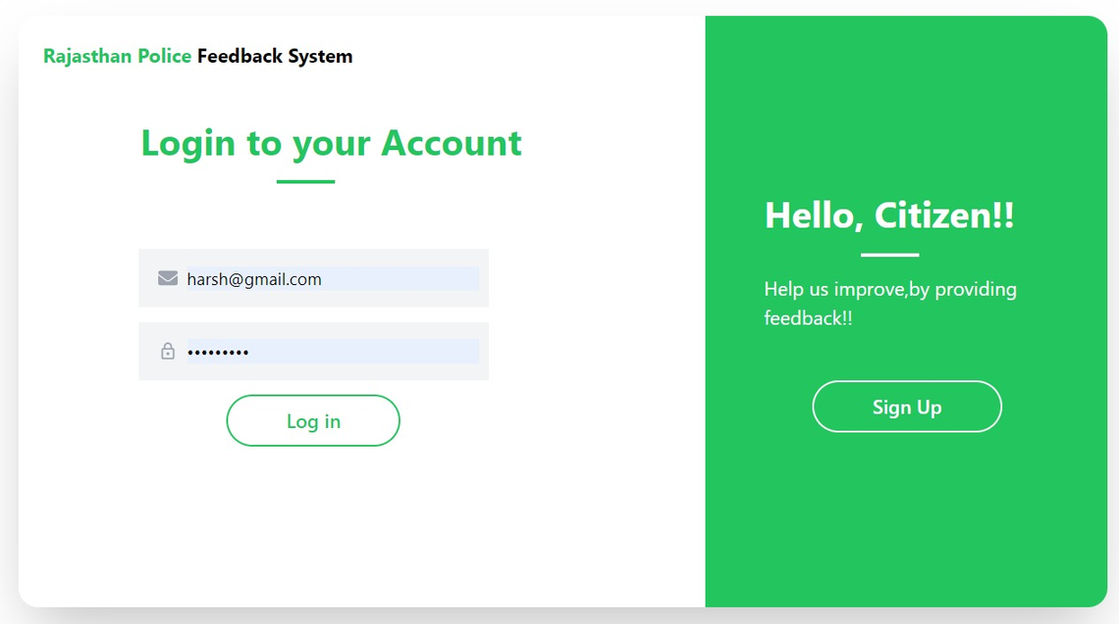
USER AUTH PAGE

Slide 19
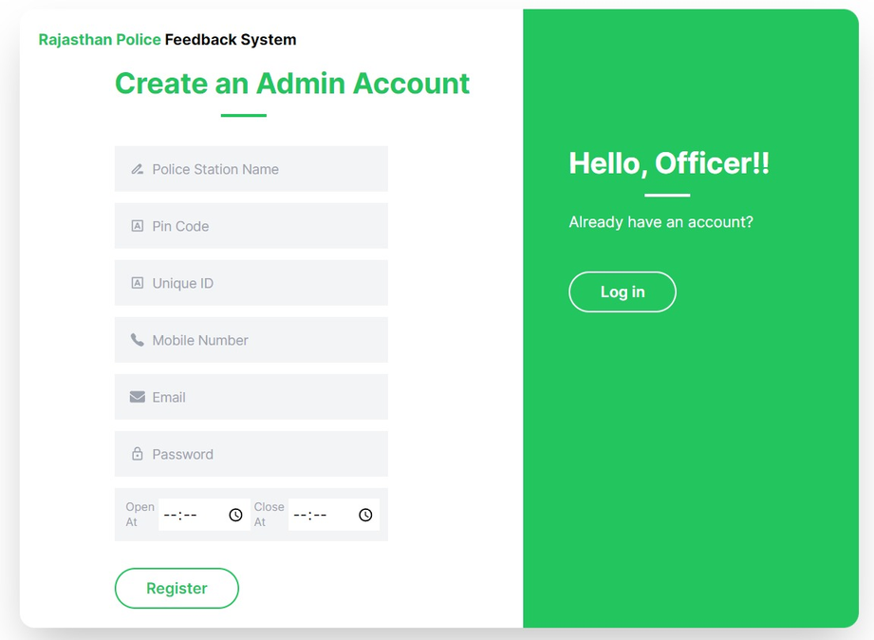
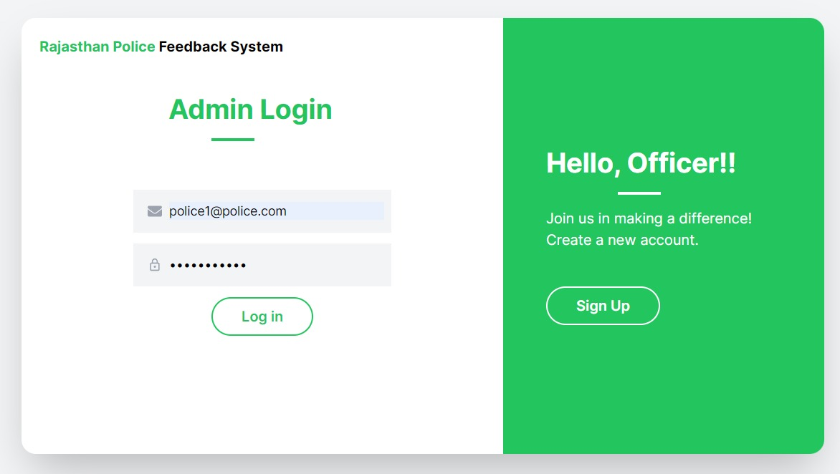
POLICE STATION AUTH

Slide 20
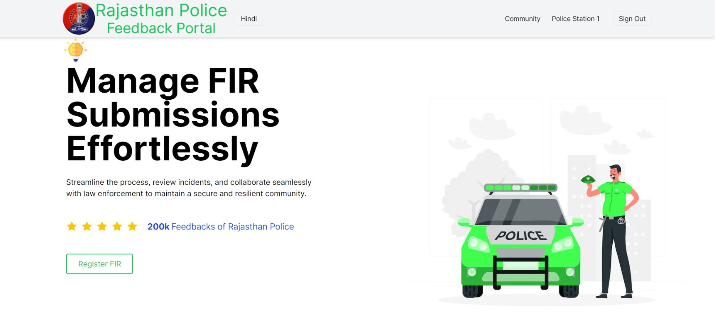
POLICE HOME PAGE

Slide 21
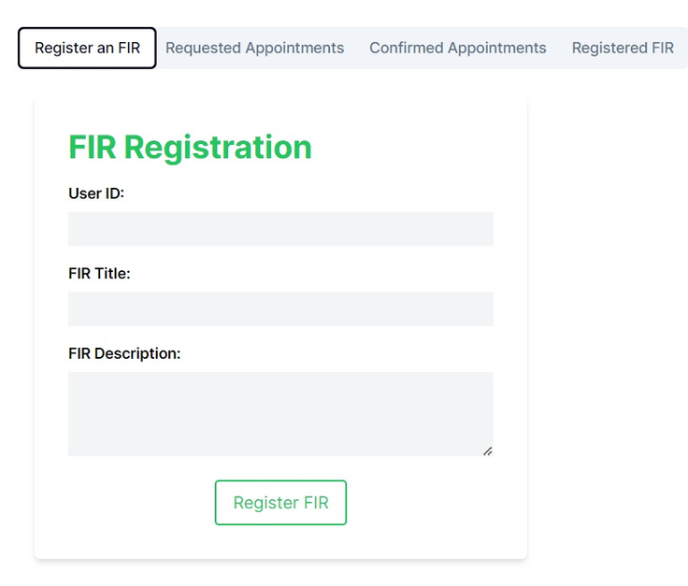
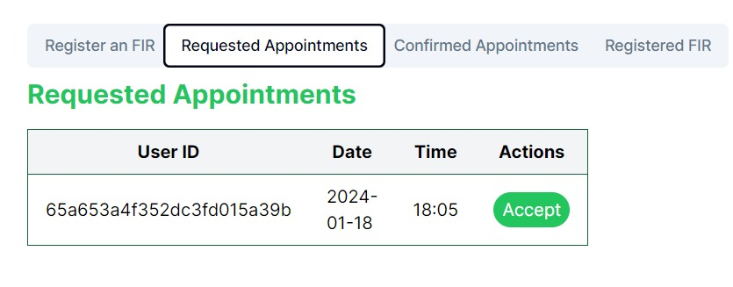
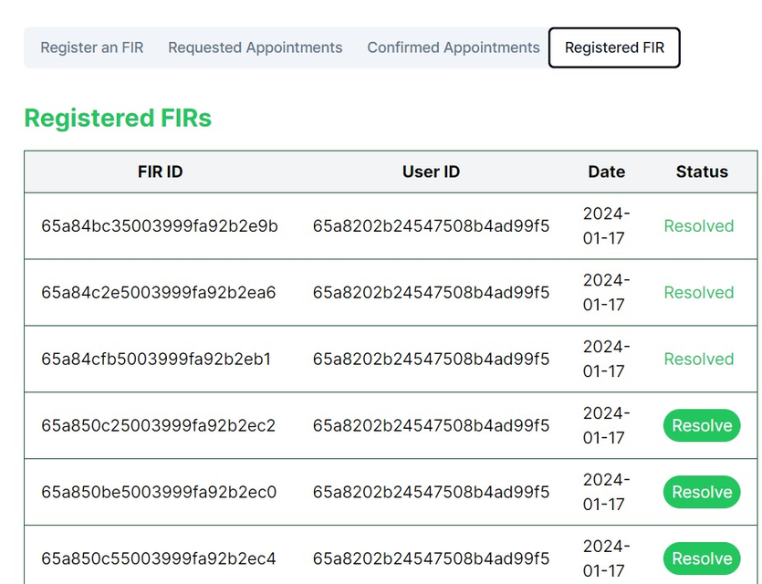
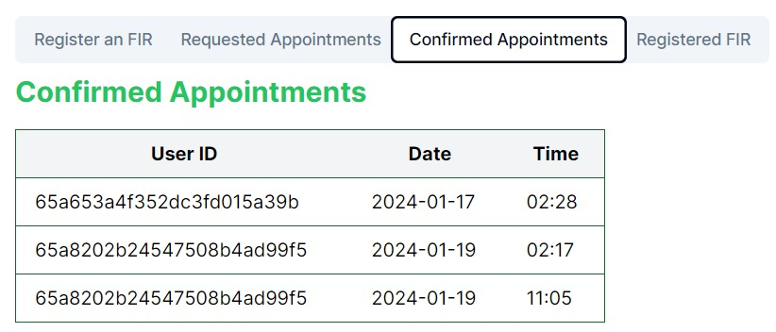
POLICE ABILITIES

Slide 22
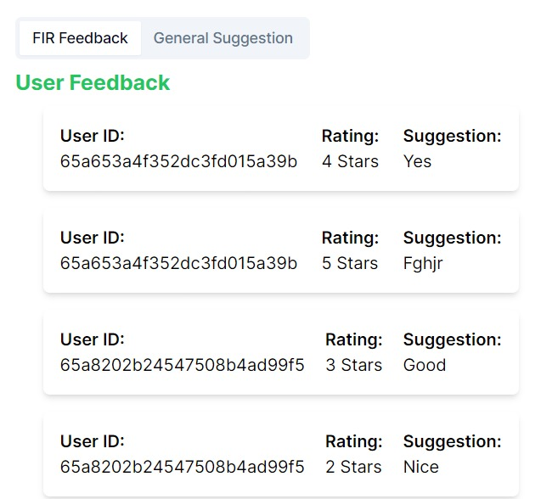
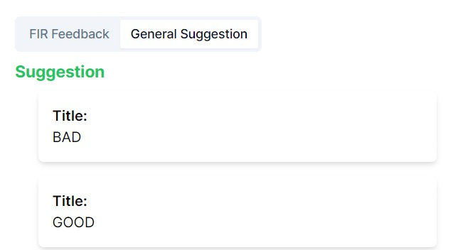
POLICE FEEDBACKS AND SUGGESTIONS

Slide 23
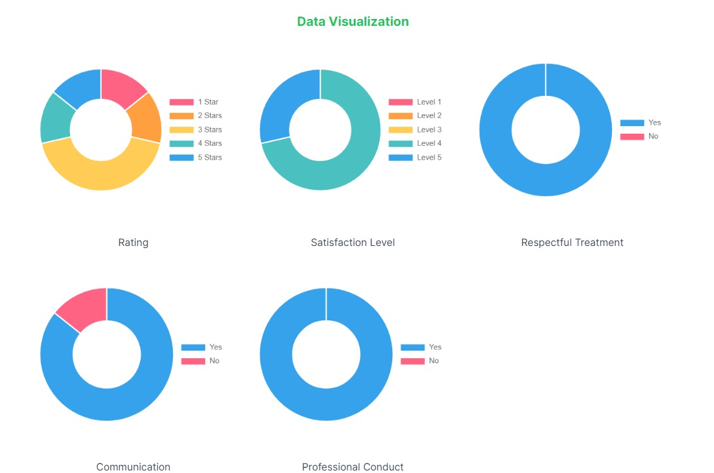
POLICE DATA ANALYTICS

Slide 24
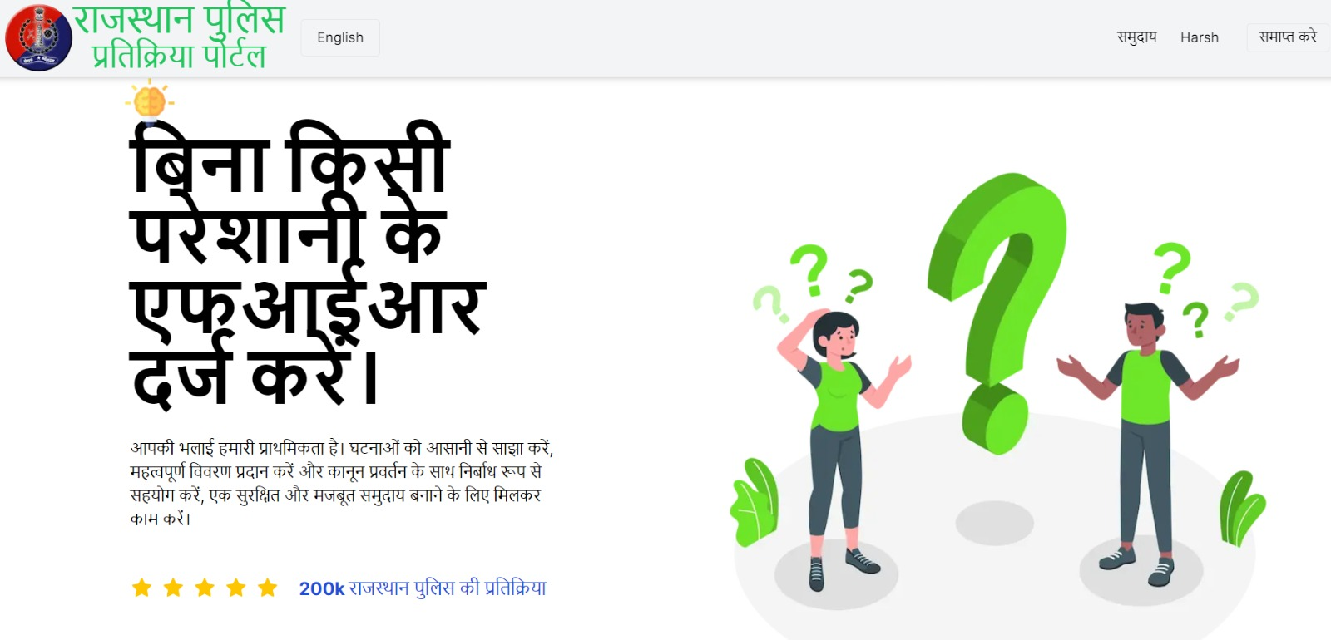
MULTI LINGUAL SUPPORT

Slide 25
THANK YOU
Team Jaipur Caps

